Slide 1
Preparation for Microsoft Exam
Friday
Lecturer: Dr. Farshid Keivanian

Slide 2
1. Freeze Rows 1 and 2
1. Open the Excel worksheet that contains the data you want to freeze.
2. Select the row below the rows you want to freeze.
In this case, the instruction asks you to freeze rows 1 and 2, so you will need to select row 3.
3. Navigate to the "View" tab on the Ribbon.
On the top bar of Excel, locate the tab labeled "View."

Slide 3
1. Freeze Rows 1 and 2
4. Click "Freeze Panes."
In the "View" tab, locate the "Window" group, and click on "Freeze Panes".
A dropdown menu will appear.
5. Choose "Freeze Panes" from the dropdown menu.
From the dropdown, select "Freeze Panes" (the first option). This will freeze both rows 1 and 2, so they remain visible as you scroll down the worksheet.

Slide 4
1. Freeze Rows 1 and 2
Confirming the Result:
Now, if you scroll down the worksheet, rows 1 and 2 will stay fixed at the top of the sheet, making the titles and column headings always visible.
This solution allows you to keep specific rows visible as you work with large datasets, improving your ability to reference important information like headers or titles while scrolling.

Slide 5
2. Client Onboarding and Billing
1. Open the Excel Worksheet:
Open the Excel file that contains the "Client Onboarding and Billing" data. If this is an existing file, ensure the "Client Billing" worksheet is selected.

Slide 6
2. Client Onboarding and Billing
2. Access the Client Billing Worksheet:
Click on the tab labeled "Client Billing" at the bottom of the Excel window to select this specific worksheet where client information, billing, and payments are tracked.

Slide 7
2. Client Onboarding and Billing
3. Change the Page Margins to Narrow:
To change the margins to "Narrow" on the "Client Billing" worksheet, follow these steps:
Click on the Page Layout tab from the top menu in Excel.
In the Page Setup group, locate the Margins dropdown.
Click on Margins and select Narrow from the list of margin options.
This will reduce the margins on all sides of the page to fit more content when printing or viewing the sheet.

Slide 8
2. Client Onboarding and Billing
4. Verify the Data:
Ensure the client data such as Client ID, Client Name, Contact, Billed Amount, and Paid Amount are correctly entered and formatted as per the requirements displayed in the screenshot.

Slide 9
2. Client Onboarding and Billing
5. Save the Changes:
After changing the margins and verifying the data, save the Excel file by clicking File > Save or using the shortcut Ctrl + S.

Slide 10
3. Creating a monthly income report for Fabrikam Residences, with some specific instructions at the bottom related to adding "Rent" as a tag in the document properties.
Step 1: Ensure Data Accuracy for Monthly Rent and Rent Increase
Review the Table:
The table contains details such as Property ID, Bedrooms, Bathrooms, Garage, Garden, Type, Monthly Rent, and Rent Increase. Double-check that the data in these columns is accurate.

Slide 11
3. Creating a monthly income report for Fabrikam Residences, with some specific instructions at the bottom related to adding "Rent" as a tag in the document properties.
2. Check Rent Data:
Ensure that the Monthly Rent and Rent Increase columns are formatted as currency values. To do this:
Select the cells under Monthly Rent and Rent Increase.
Right-click and choose Format Cells.
Under Number, select Currency and ensure the correct currency symbol is displayed.

Slide 12
Step 2: Add Rent as a Tag to the Document Properties
Access Document Properties:
Click on the File tab in Excel to go to the backstage view.
On the left sidebar, choose Info.
Add Tags:
In the Properties section (on the right side), look for Tags.
Click on Add a tag, and type in “Rent”.
Press Enter to save the tag.

Slide 13
Step 3: Optional Formatting (If Required)
Table Formatting:
If needed, apply table formatting for a more organized look:
Select the entire table.
Go to the Home tab and click on Format as Table. Choose a table style you like.
Column Adjustments:
Adjust the column widths so that all data is visible and properly aligned.

Slide 14
Step 4: Save the Report
Save the Excel Sheet:
After adding the tag and ensuring the data is accurate, save the file.
You can save it as a regular Excel file (.xlsx) or, if required, export it as a PDF by going to File > Export > Create PDF/XPS Document.

Slide 15
Step 5: Mark the Project as Complete
Complete the Project:
Once the steps are done, return to the project interface (bottom section of the screen).
Click on Mark Complete to finish this project step.

Slide 16
4. Preparing a report of student exam results. The instruction at the bottom specifies that you need to configure the "Students" worksheet so that only cells C3:E18 will print.
Step 1: Select the Range to Print
Open the Students worksheet in Excel (as indicated in the instruction).
Select the range C3
:
Click and drag from cell C3 down to E18, highlighting the desired range.

Slide 17
4. Preparing a report of student exam results. The instruction at the bottom specifies that you need to configure the "Students" worksheet so that only cells C3:E18 will print.
Step 2: Set Print Area
Once you have selected the range (C3), go to the Page Layout tab on the Excel ribbon.
In the Page Setup group, click Print Area, then choose Set Print Area.
This ensures that only the selected range (C3) will be printed.

Slide 18
4. Preparing a report of student exam results. The instruction at the bottom specifies that you need to configure the "Students" worksheet so that only cells C3:E18 will print.
Step 3: Preview the Print Setup (Optional)
To ensure that the correct range has been set, you can check the print preview:
Go to the File tab and select Print or press Ctrl + P to open the print preview.
Verify that only cells C3 are included in the preview.

Slide 19
4. Preparing a report of student exam results. The instruction at the bottom specifies that you need to configure the "Students" worksheet so that only cells C3:E18 will print.
Step 4: Adjust Page Layout (If Needed)
If the print area doesn’t fit well on the page, you can adjust the scaling or layout:
In the Print options, look for Scaling and choose Fit Sheet on One Page or another appropriate scaling option.
You can also adjust margins, orientation (Portrait or Landscape), or other layout settings under Page Setup to ensure the printout looks professional.

Slide 20
4. Preparing a report of student exam results. The instruction at the bottom specifies that you need to configure the "Students" worksheet so that only cells C3:E18 will print.
Step 5: Save the File
Once the print area has been set and previewed, save the file to ensure the changes are saved.
Go to File > Save As, and save the document with the appropriate name.

Slide 21
4. Preparing a report of student exam results. The instruction at the bottom specifies that you need to configure the "Students" worksheet so that only cells C3:E18 will print.
Step 6: Mark the Project Complete
Once the configuration is done, return to the interface and click Mark Complete at the bottom of the screen to finish this step of the project.

Slide 22
5. Inserting a hyperlink in Excel on the "Roasting" worksheet, specifically in cell A10, that links to the website https://www.fourthcoffee.com and displays the text "More Information" in the cell.
Step-by-Step Solution to Insert a Hyperlink in Excel
Step 1: Open the Correct Worksheet
Navigate to the Roasting worksheet by clicking on the "Roasting" tab at the bottom of the Excel workbook.

Slide 23
5. Inserting a hyperlink in Excel on the "Roasting" worksheet, specifically in cell A10, that links to the website https://www.fourthcoffee.com and displays the text "More Information" in the cell.
Step 2: Select Cell A10
Click on cell A10 in the "Roasting" worksheet where you need to insert the hyperlink.
Step 3: Insert the Hyperlink
With cell A10 selected, go to the Insert tab in the Excel ribbon (located at the top of the screen).
In the Links group, click on Hyperlink (you can also press Ctrl + K to open the hyperlink dialog box).

Slide 24
5. Inserting a hyperlink in Excel on the "Roasting" worksheet, specifically in cell A10, that links to the website https://www.fourthcoffee.com and displays the text "More Information" in the cell.
Step 4: Set the Hyperlink URL
In the "Insert Hyperlink" dialog box:
Under Link to, select Existing File or Web Page.
In the Address field at the bottom of the dialog box, type or paste the URL: https://www.fourthcoffee.com.

Slide 25
5. Inserting a hyperlink in Excel on the "Roasting" worksheet, specifically in cell A10, that links to the website https://www.fourthcoffee.com and displays the text "More Information" in the cell.
Step 5: Set the Display Text
In the Text to Display box (at the top of the dialog), type the text More Information.
Step 6: Finalize the Hyperlink
Click OK to insert the hyperlink into cell A10.

Slide 26
5. Inserting a hyperlink in Excel on the "Roasting" worksheet, specifically in cell A10, that links to the website https://www.fourthcoffee.com and displays the text "More Information" in the cell.
Step 7: Verify the Hyperlink
After inserting the hyperlink, hover over cell A10 to check if the link directs to https://www.fourthcoffee.com and that the text displayed is More Information.
You can click the link to test it, making sure it redirects you to the correct website.

Slide 27
5. Inserting a hyperlink in Excel on the "Roasting" worksheet, specifically in cell A10, that links to the website https://www.fourthcoffee.com and displays the text "More Information" in the cell.
Step 8: Save the Workbook
Once the hyperlink is correctly inserted, save the workbook by pressing Ctrl + S or going to File > Save.
Step 9: Mark the Project as Complete
Once all steps are complete, go back to the project interface and click on Mark Complete or Submit Project to finish the task.

Slide 28
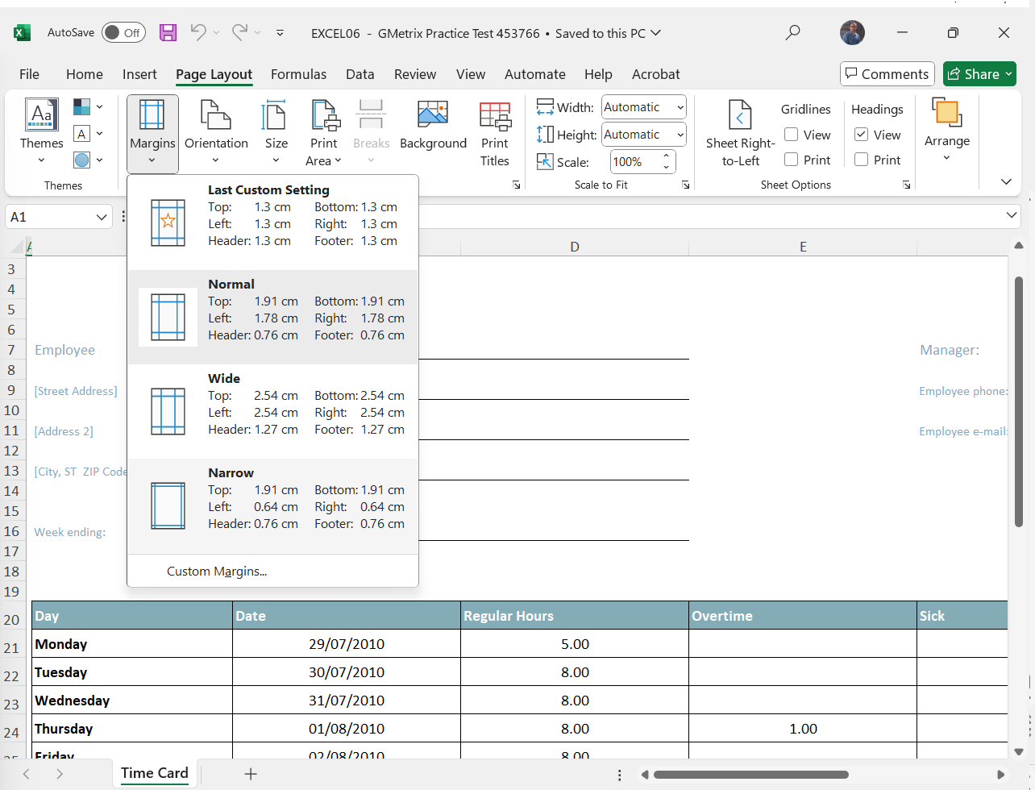
6. Change the margins to the Narrow setting.

Slide 29
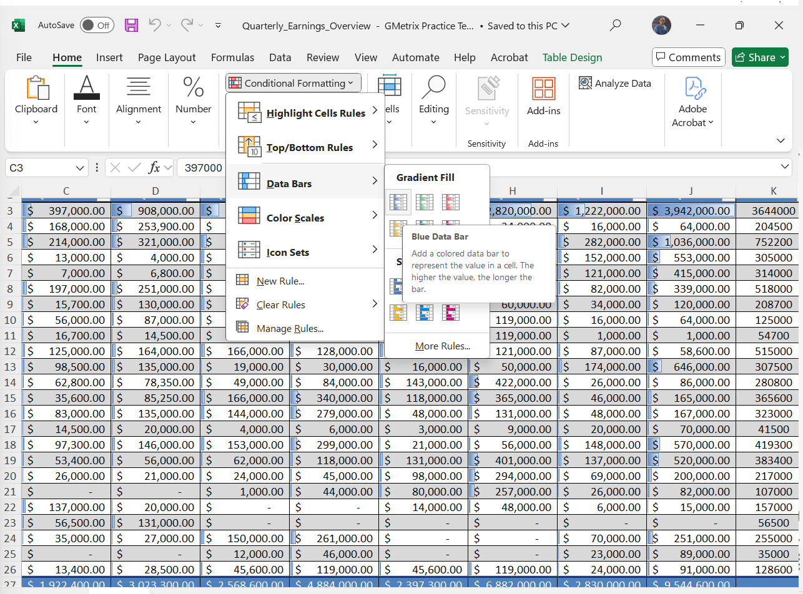
7. Conditional Formatting
With the cell range C3:J26, apply conditional formatting using blue gradient data bars.

Slide 30
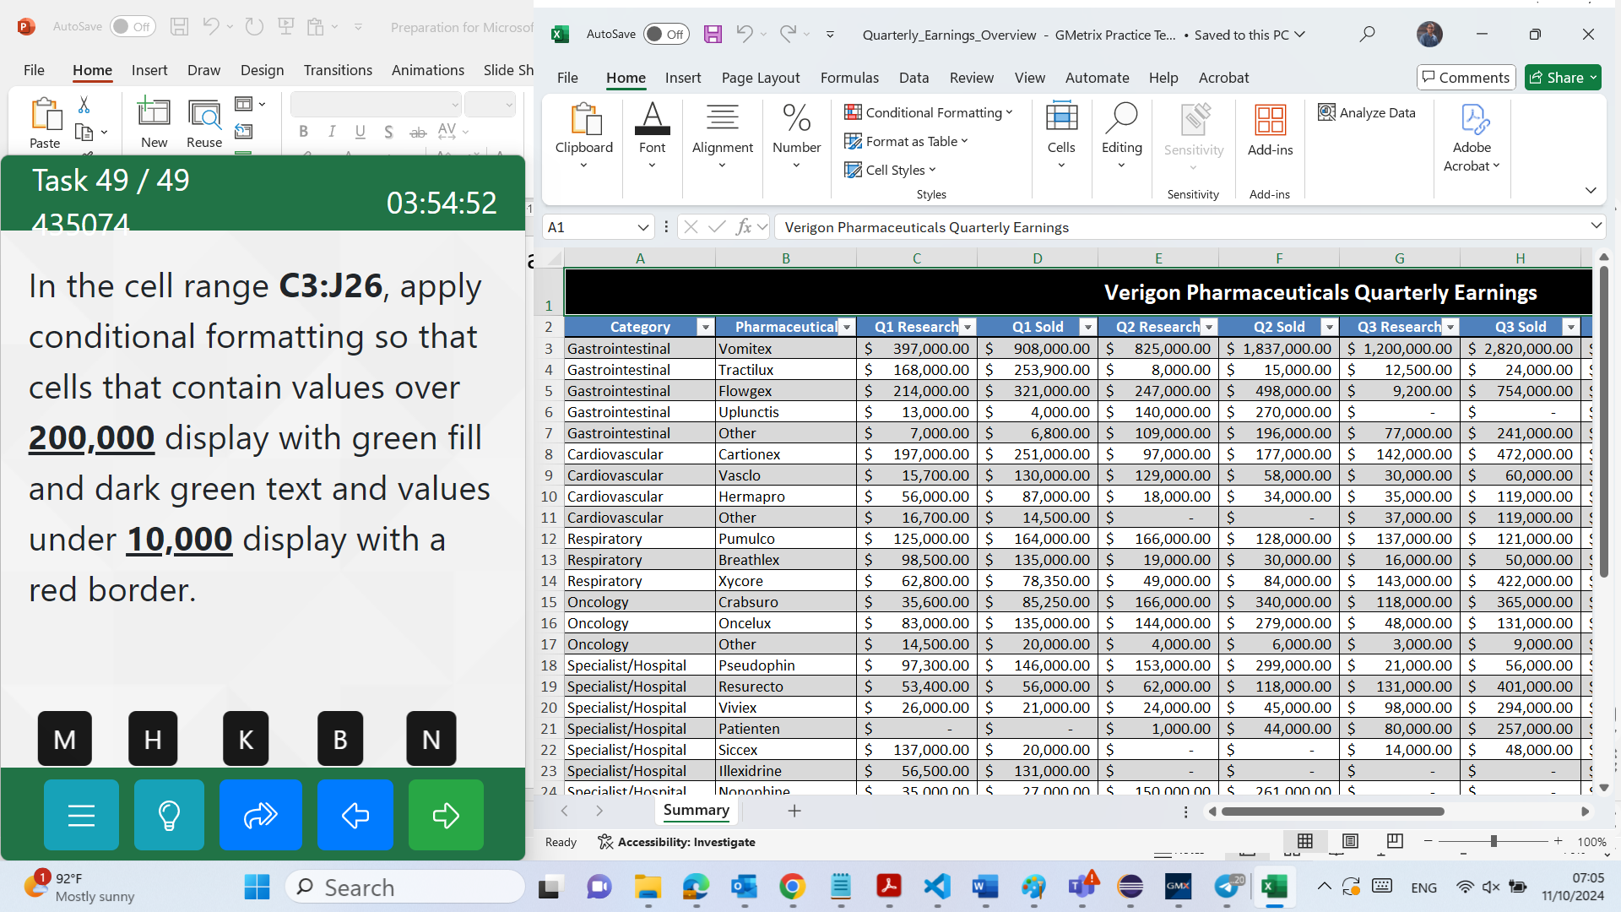
7. Conditional Formatting

Slide 31
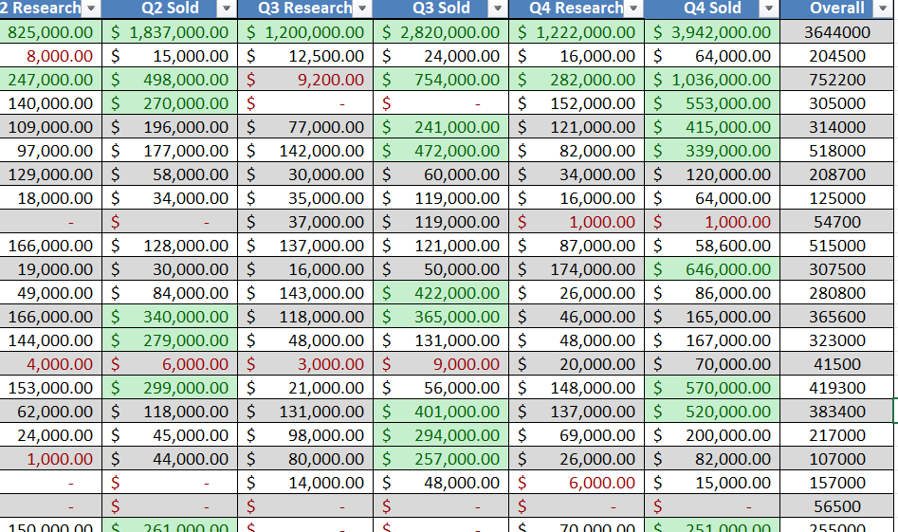
1. Select Cells C3:J26. 2. In the Home tab, in the Styles group, click the dropdown arrow for Conditional Formatting and select Highlight Cells Rules > Greater Than… 3. In the Greater Than dialog, enter 200000, and in the with dropdown select Green Fill with Dark Green Text. 4. Click OK. 5. In the Home tab, in the Styles group, click the dropdown arrow for Conditional Formatting and select Highlight Cells Rules > Less Than… 6. In the Less Thandialog box, enter 10000, and in the with dropdown select Red Border. 7. Click OK.

Slide 32
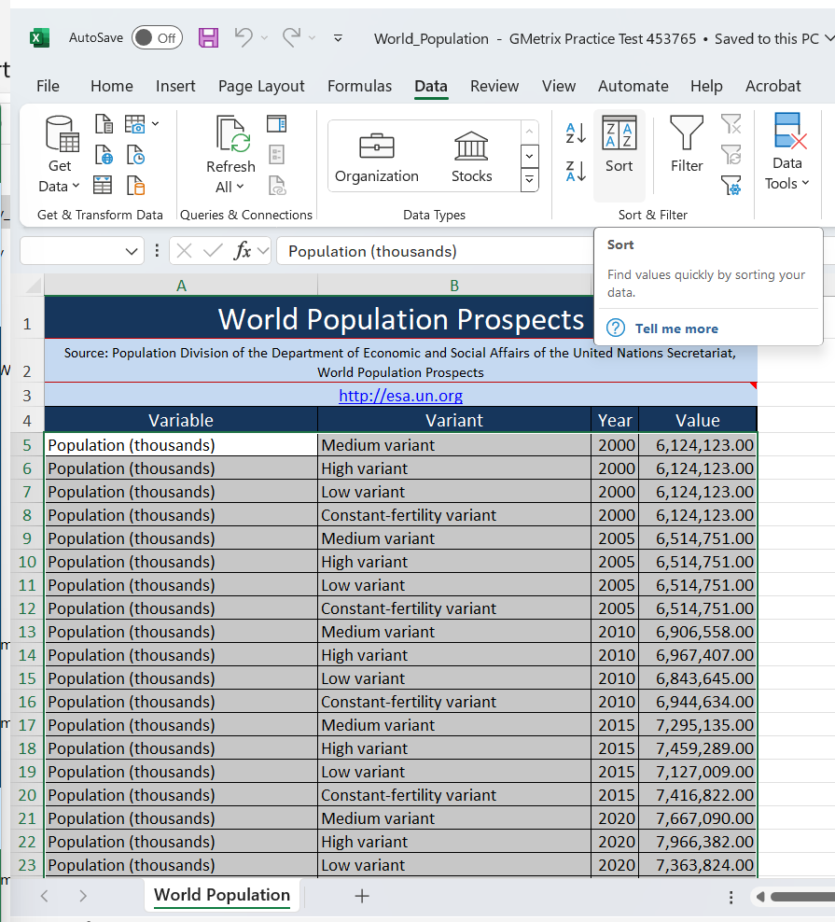
8. Sort the data
Sort the table data by the Variant column and then by the Year column in ascending order
1. Select cells A5:D106. 2. In the Data tab, in the Sort & Filter group, select Sort. 3. In the Sort dialog box, in the Sort by dropdown, select Variant. 4. Select Add Level and in the Then by dropdown, select Year and click OK.

Slide 33
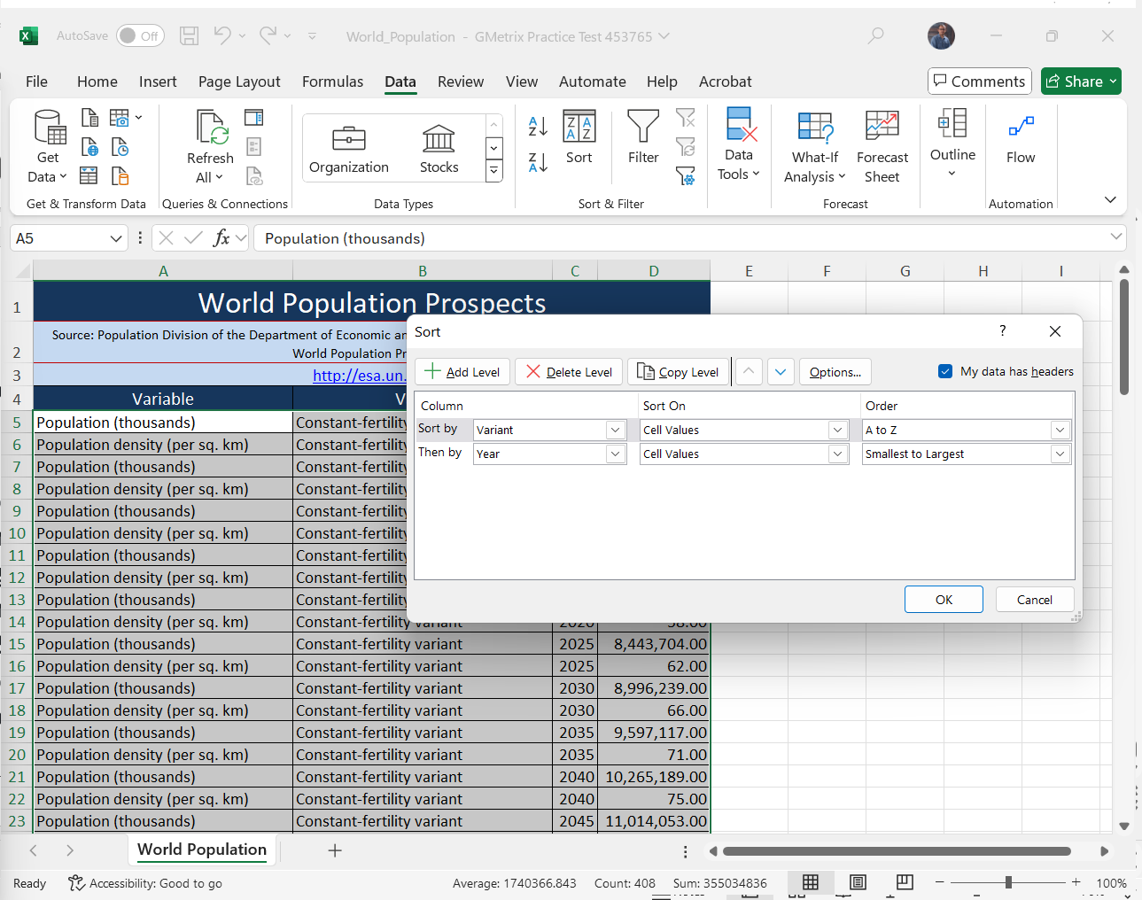
8. Sort the data
Sort the table data by the Variant column and then by the Year column in ascending order
1. Select cells A5:D106. 2. In the Data tab, in the Sort & Filter group, select Sort. 3. In the Sort dialog box, in the Sort by dropdown, select Variant. 4. Select Add Level and in the Then by dropdown, select Year and click OK.

Slide 34
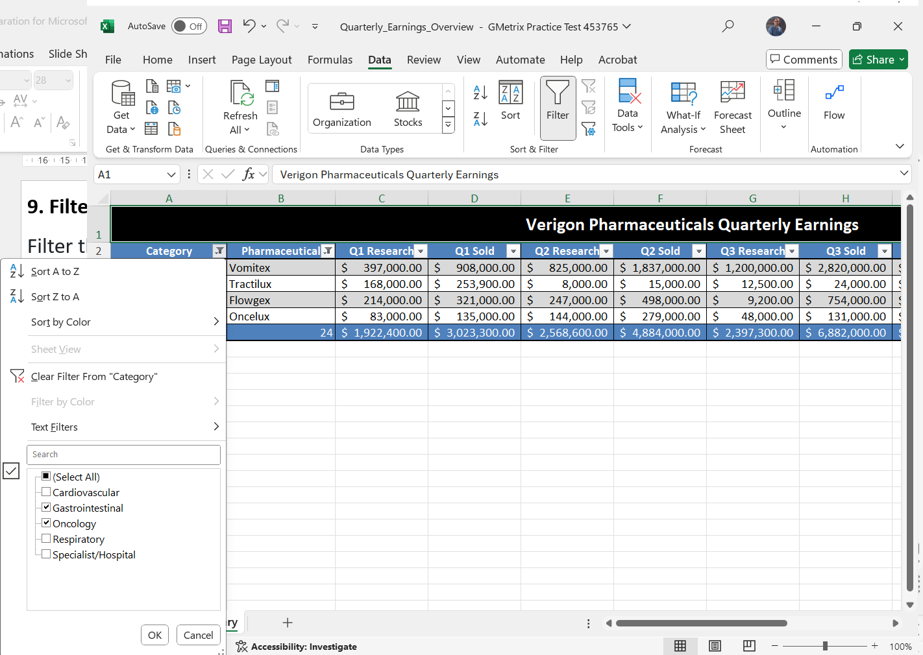
9. Filter the table
Filter the table to display data from only the Oncology and Gastrointestinal categories and those pharmaceuticals that end with the suffix ex or lux.

Slide 35
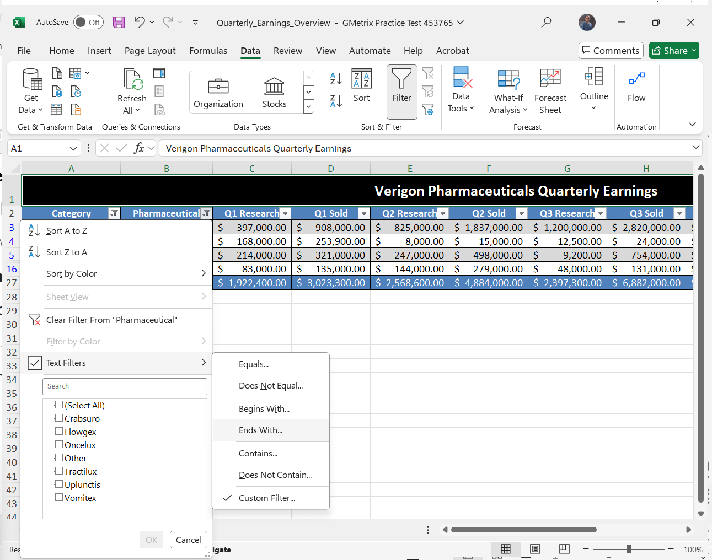
9. Filter the table
Filter the table to display data from only the Oncology and Gastrointestinal categories and those pharmaceuticals that end with the suffix ex or lux.

Slide 36
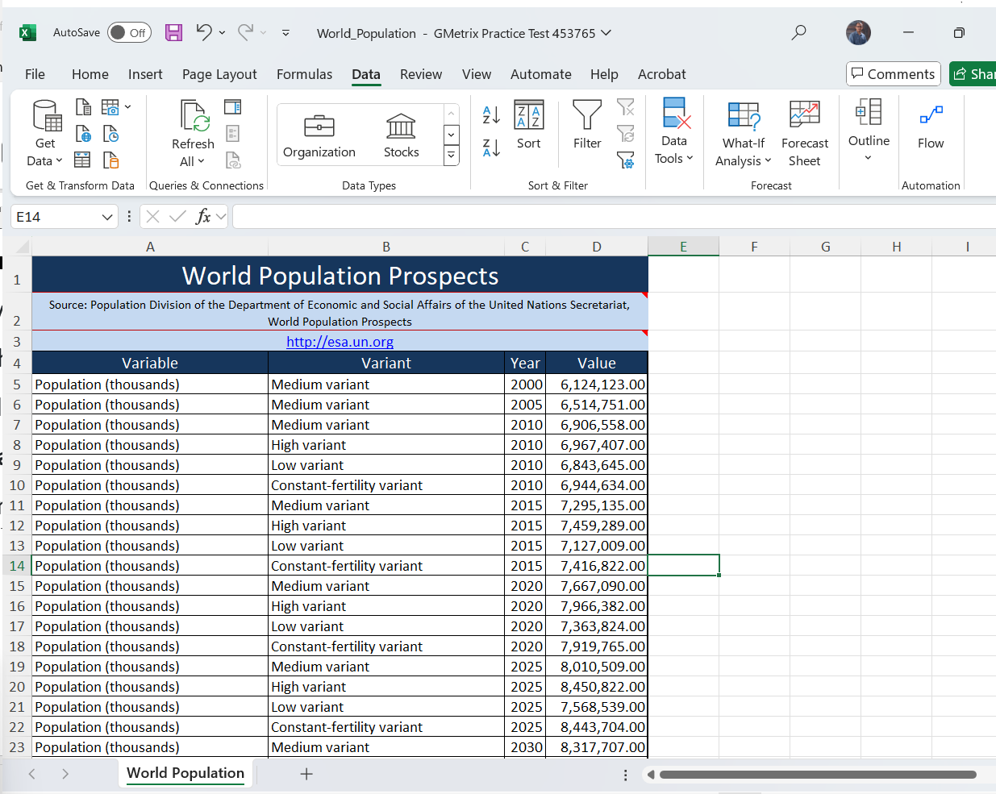
10. Remove duplicates
Remove all duplicates from the table based on the values in the Year and Value columns.

Slide 37
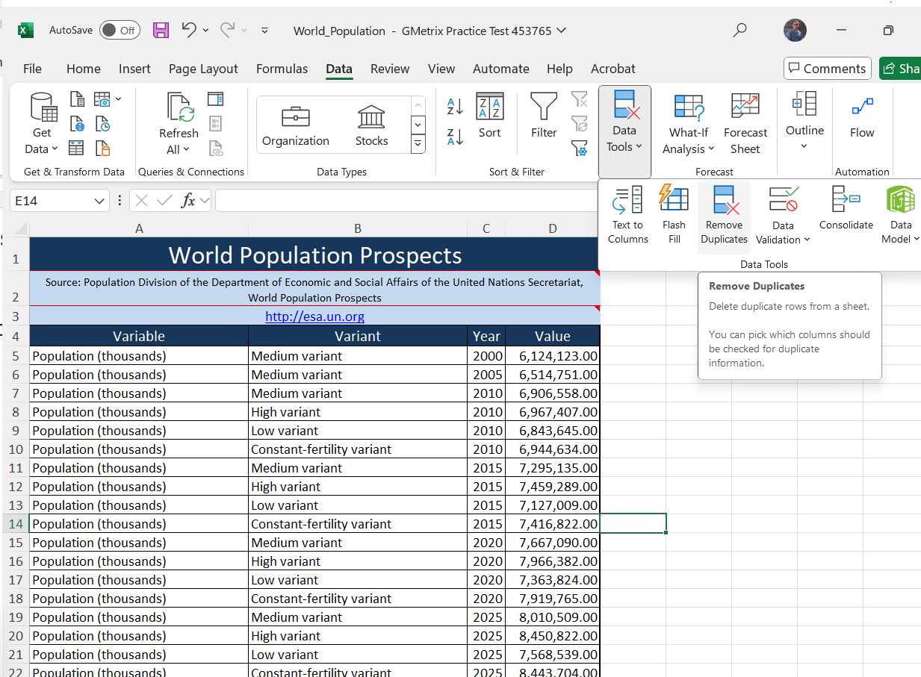
10. Remove duplicates
Remove all duplicates from the table based on the values in the Year and Value columns.
1. Select cells A5:D106. 2. In the Data tab, in the Data Tools group, select Remove Duplicates. 3. In the Columns list, clear the Variable and Variant check boxes. 4. Click OK twice.

Slide 38
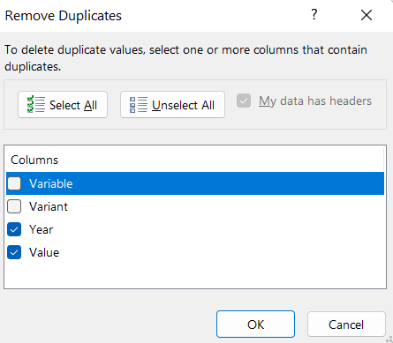
10. Remove duplicates
Remove all duplicates from the table based on the values in the Year and Value columns.
1. Select cells A5:D106. 2. In the Data tab, in the Data Tools group, select Remove Duplicates. 3. In the Columns list, clear the Variable and Variant check boxes. 4. Click OK twice.

Slide 39
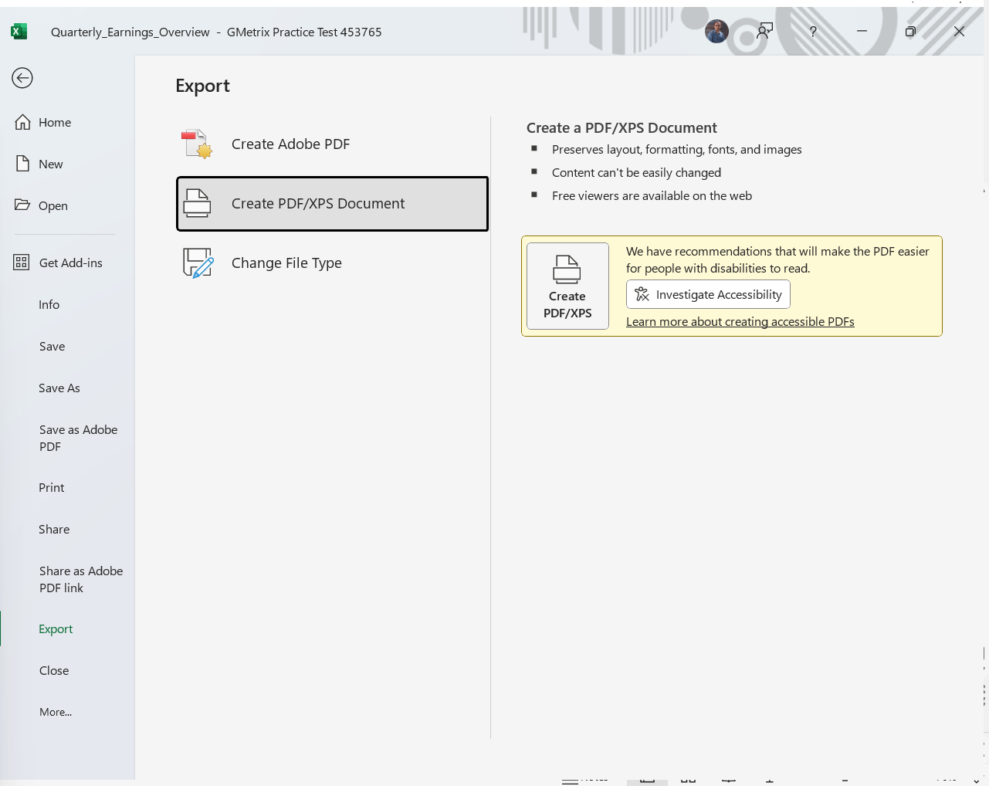
11. Save As PDF
Save the entire workbook as a PDF file in your GMetrixTemplates folder, omitting document properties and tags.

Slide 40
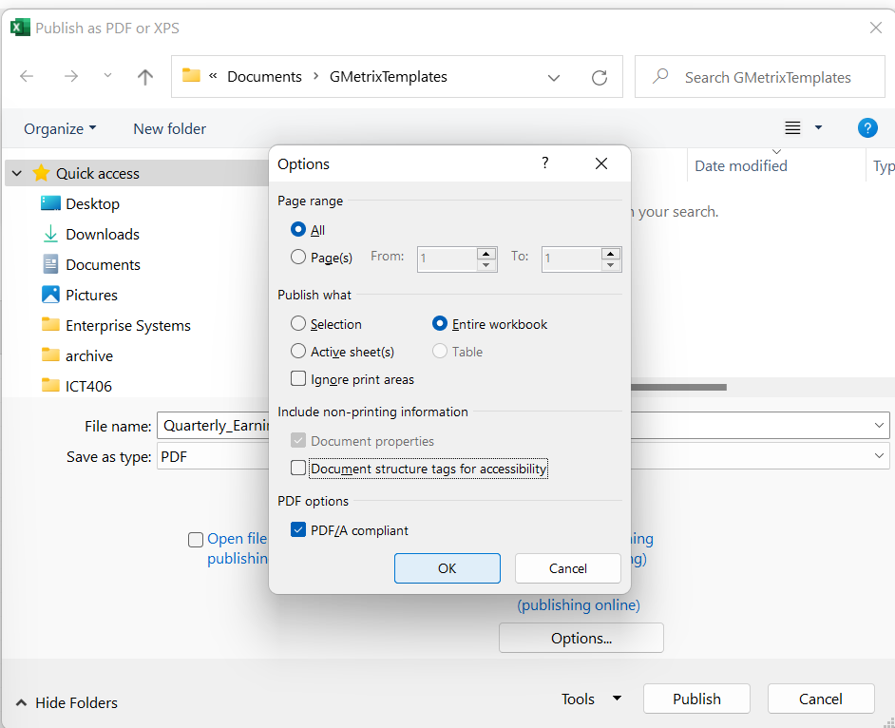
11. Save As PDF Entire WorkBook no tags
1. Select the File tab and choose Export. 2. Select Create PDF/XPS Documentand click Create PDF/XPS and navigate to the GMetrixTemplates folder.

Slide 41
3. In the Publish as PDF or XPS dialog box, select Options. 4. In the Optionsdialog box, under Publish what, select Entire Workbook and clear the check boxes Document properties and Document structure tags for accessibility. 5. Click OK. 6. Click Publish.

Slide 42
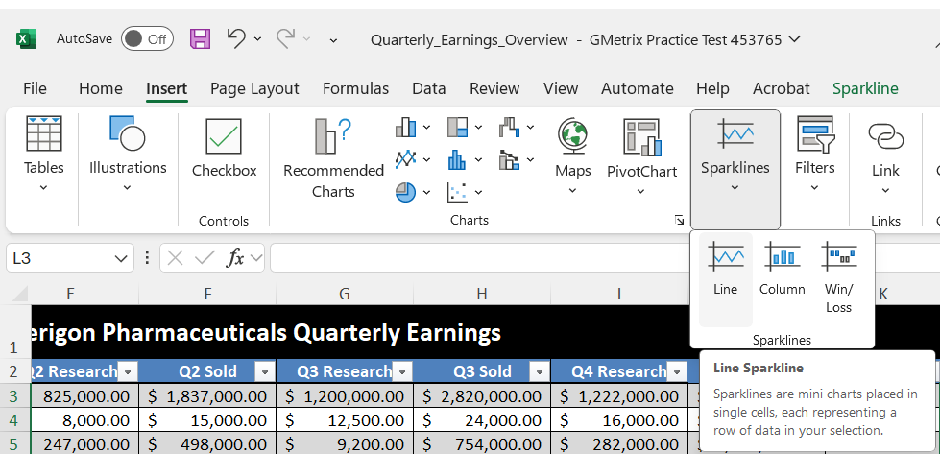
12. Sparkline
Using Autofill, add a Line sparkline to column L using the data in columns C through J.
1. Select cell L3. 2. In the Insert tab, in the Sparklines group, select Line.

Slide 43
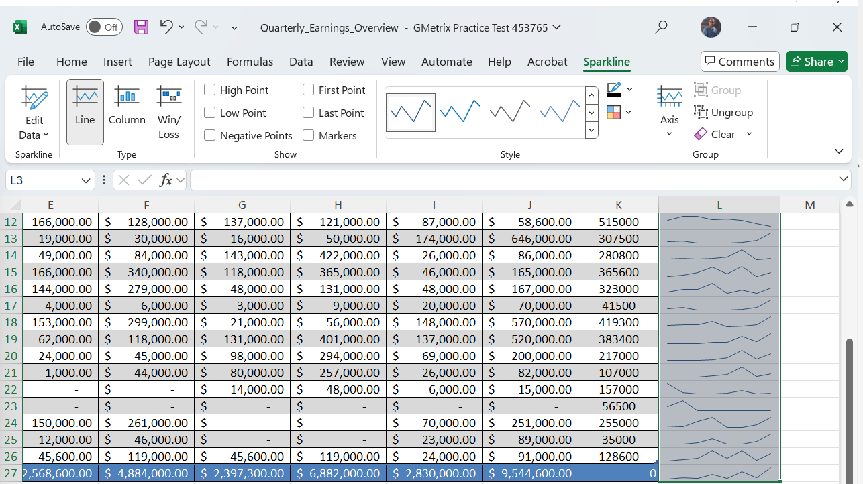
3. In the Create Sparklines dialog box, for Data Range enter C3:J3. 4. Click OK. 5. Move your cursor over the AutoFill handle at the lower-right corner of the cell. (The pointer should change from a thick white cross to a thin black cross.) 6. Click and drag to cell L27 and release the mouse button.

Slide 44
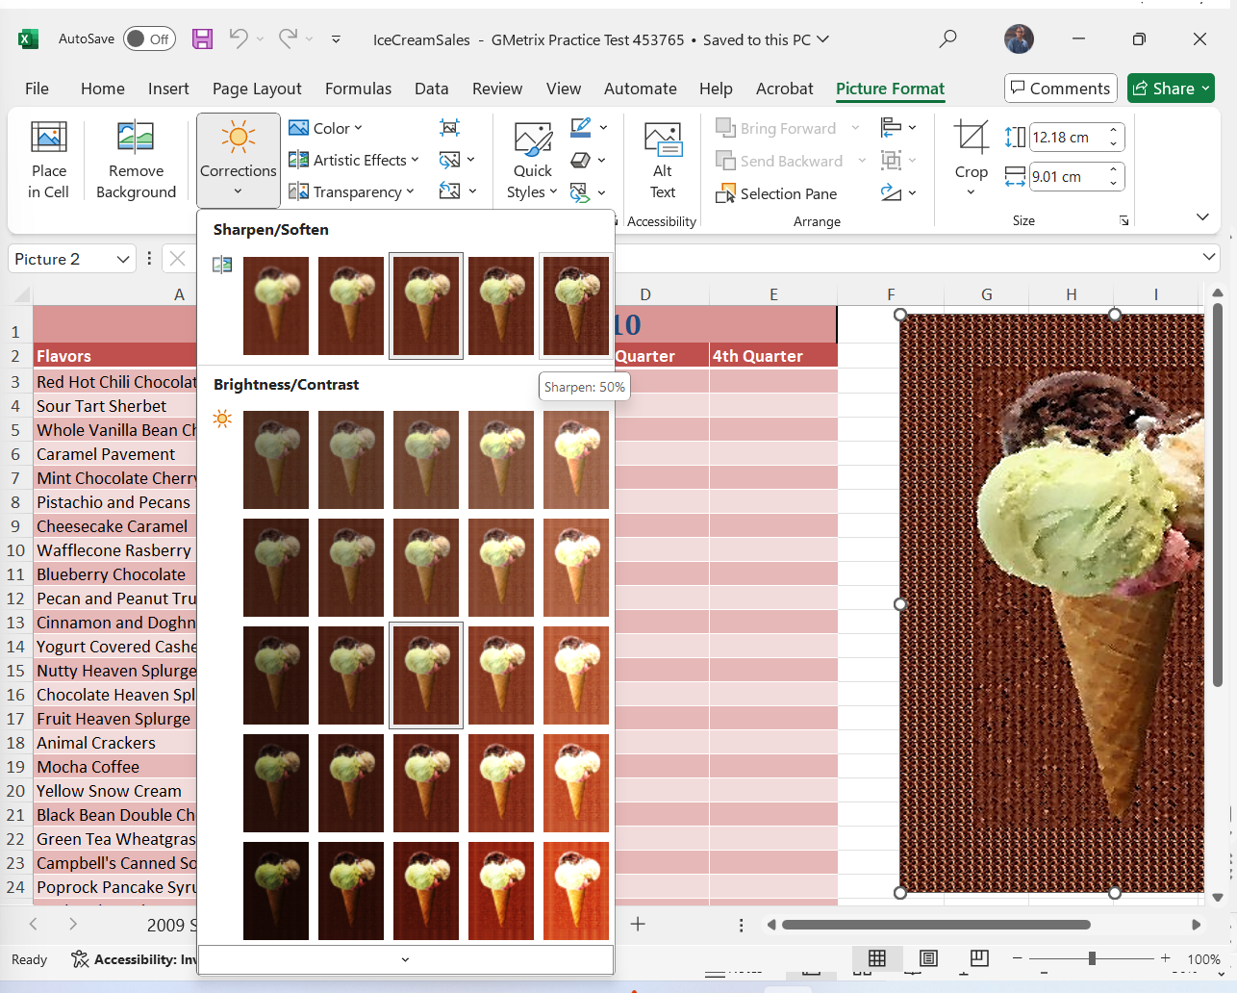
13. Sharpen photo
In the Summary worksheet, sharpen by 50% and apply the Watercolor Spongeartistic effect to the image.
1. Select the ice cream image. 2. In the Picture Formatcontextual tab, in the Adjustgroup, click the dropdown arrow for Corrections and select Sharpen: 50%.

Slide 45
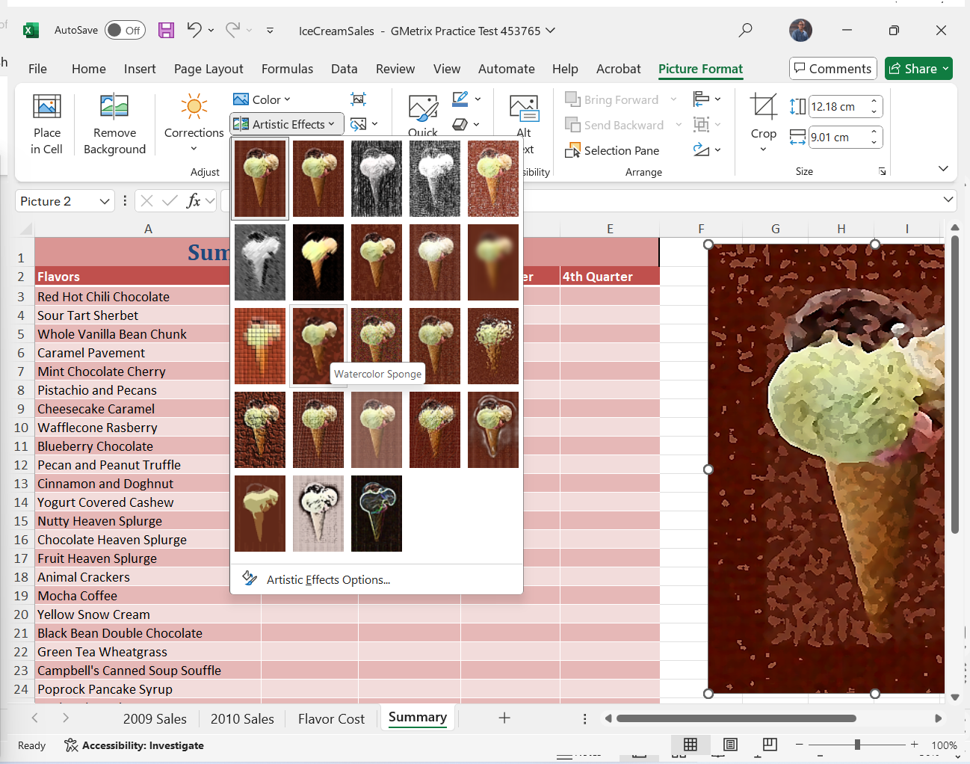
13. Sharpen photo
In the Summary worksheet, sharpen by 50% and apply the Watercolor Spongeartistic effect to the image.
3. In the Picture Formatcontextual tab, in the Adjustgroup, click the dropdown arrow for Artistic Effects and select Watercolor Sponge.

Slide 46
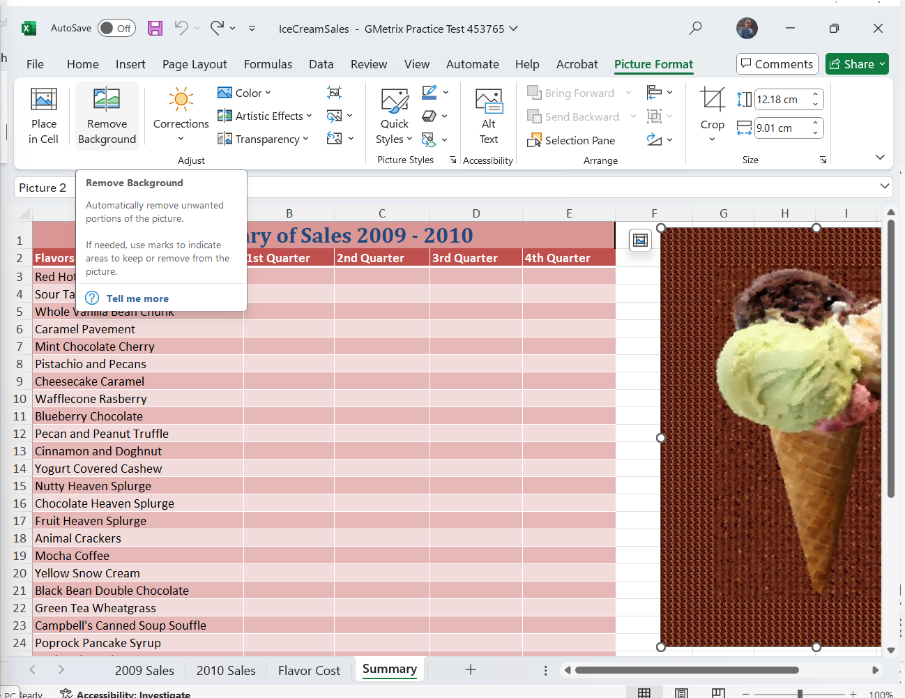
14. Remove Background Colour
In the Summary worksheet, remove the background of the ice cream image.
1. Select the Summary worksheet. 2. Select the ice cream image. 3. In the Picture Format contextual tab, in the Adjustgroup, select Remove Background.

Slide 47
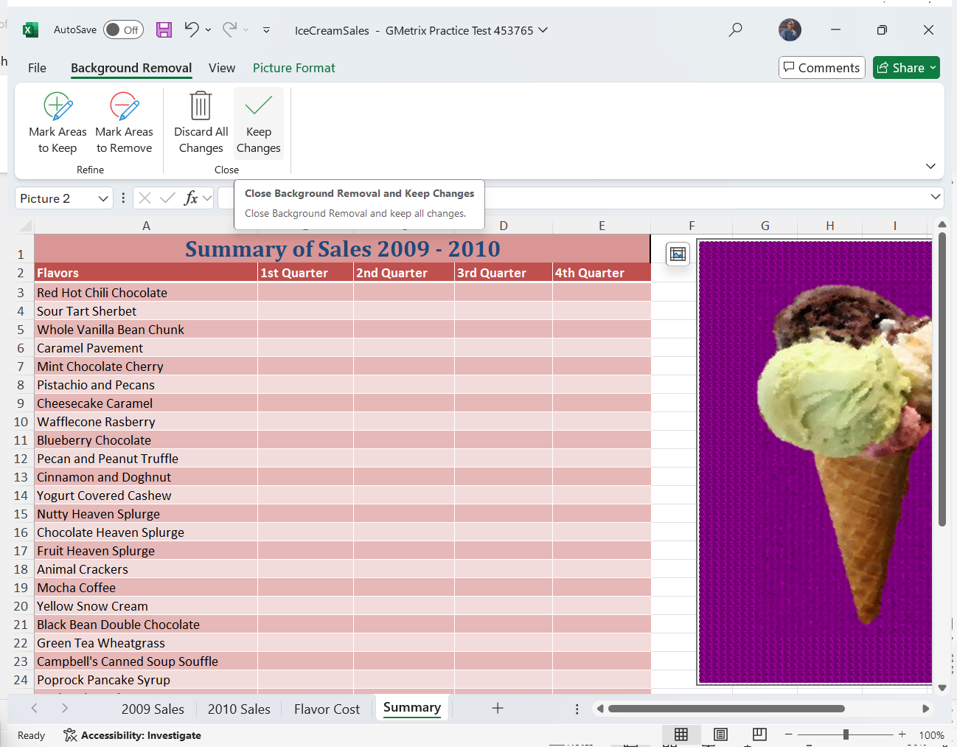
14. Remove Background Colour
In the Summary worksheet, remove the background of the ice cream image.
4. In the Background Removal contextual tab, in the Close group, select Keep Changes.

Slide 48
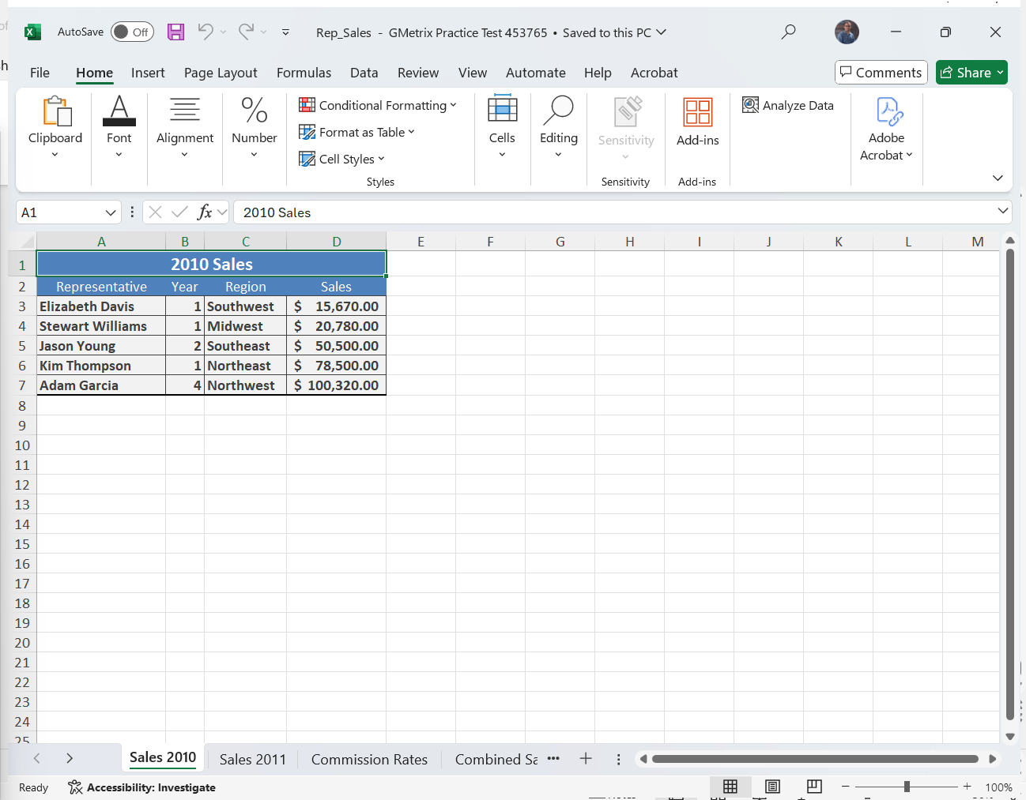
15. Add a Pie Chart
Using the data in the Combined Sales worksheet, add a Pie chart including labels that presents the combined sales for each representative.
1. Select the Combined Sales worksheet. 2. Select cells E2:E7. 3. In the Insert tab, in the Charts group, click the dropdown arrow for Pie and select Pie in the 2D Pie section.

Slide 49
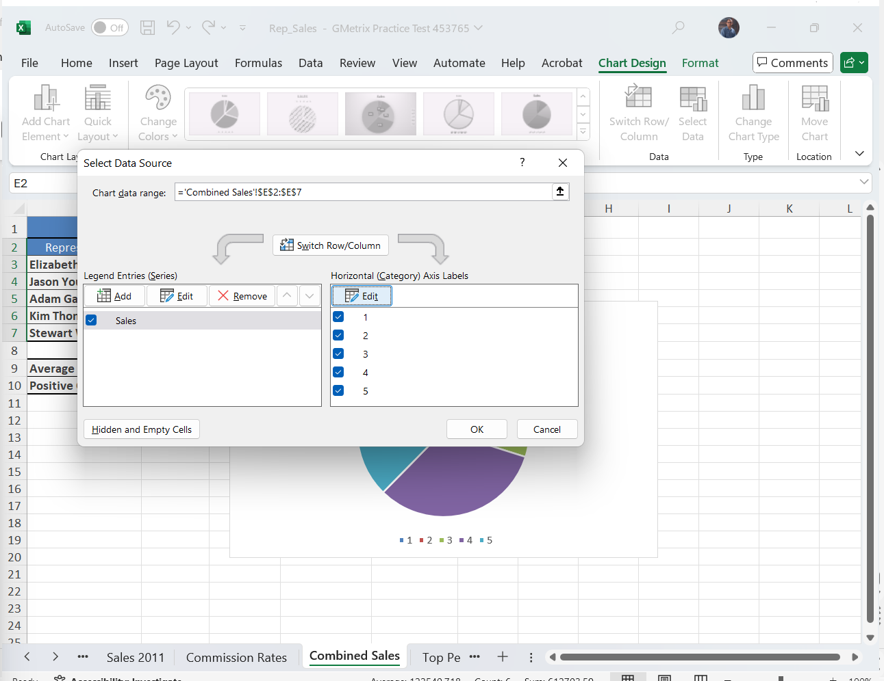
15. Add a Pie Chart
Using the data in the Combined Sales worksheet, add a Pie chart including labels that presents the combined sales for each representative.
4. Select the Chart, and in the Chart Design contextual tab, in the Data group, choose Select Data. 5. In the Select Data Source dialog, in the Horizontal (Category) Axis Labels section, select Edit. 6. Select cells A3:A7. 7. Click OK twice.

Slide 50
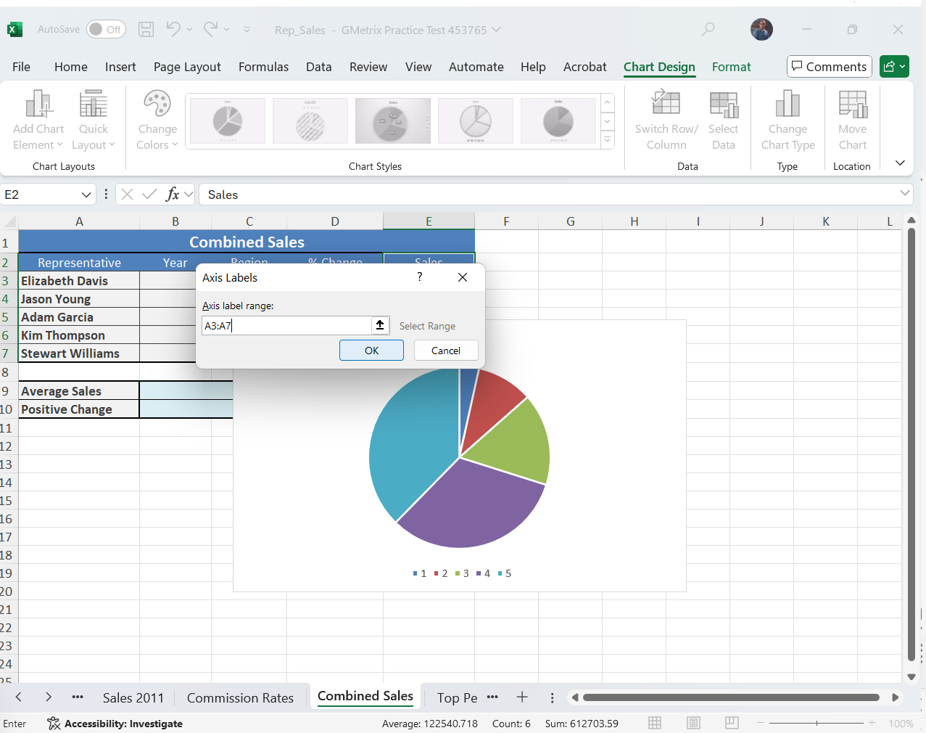
15. Add a Pie Chart
Using the data in the Combined Sales worksheet, add a Pie chart including labels that presents the combined sales for each representative.
4. Select the Chart, and in the Chart Design contextual tab, in the Data group, choose Select Data. 5. In the Select Data Source dialog, in the Horizontal (Category) Axis Labels section, select Edit. 6. Select cells A3:A7. 7. Click OK twice.

Slide 51
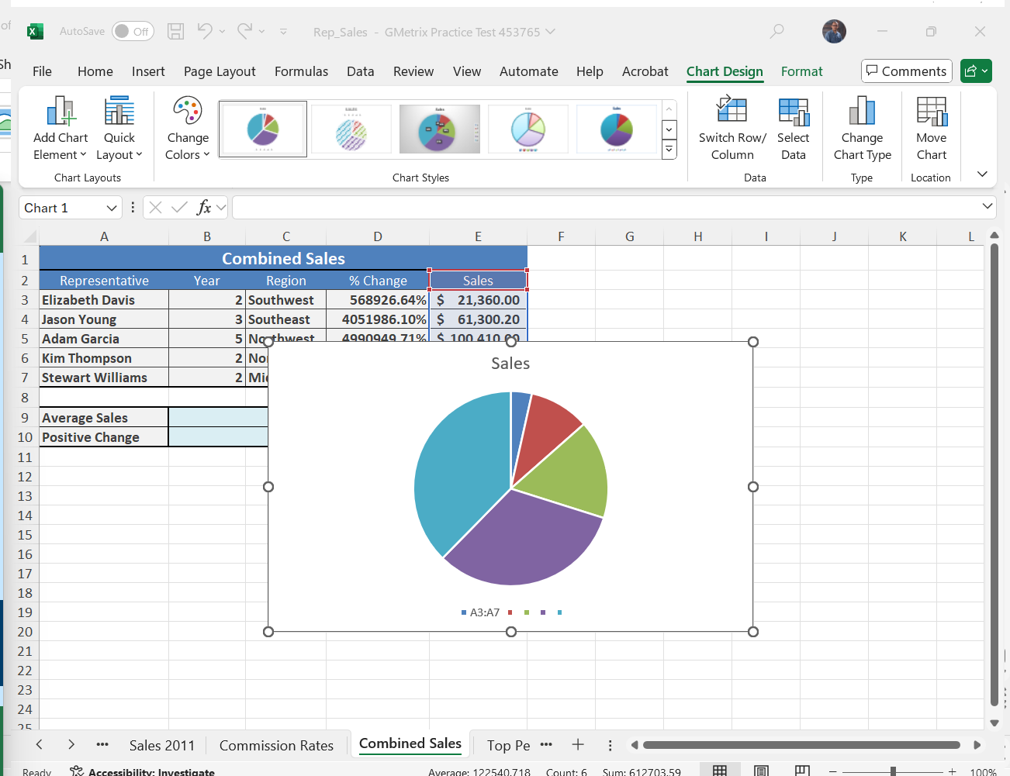
15. Add a Pie Chart
Using the data in the Combined Sales worksheet, add a Pie chart including labels that presents the combined sales for each representative.
4. Select the Chart, and in the Chart Design contextual tab, in the Data group, choose Select Data. 5. In the Select Data Source dialog, in the Horizontal (Category) Axis Labels section, select Edit. 6. Select cells A3:A7. 7. Click OK twice.

